Slide 1
USSGL Accounts Ballot Items &
Upcoming Projects
USSGL Board Meeting May 10, 2018

Slide 2
Agenda
Fiscal Year 2018 Ballot Items
Custodial USSGL Accounts (FY19)
Reduction Liability Account (FY19)
USSGL Projects

Slide 3
Fiscal Year 2018 Ballot Items
411601 Debt Forgiveness – Cancellation of Debt Adjustment
This new USSGL account is needed to capture and distinguish a unique form of an adjustment to budgetary resources that cancels outstanding debt. Created for FEMA.
232000 Other Deferred Revenue
This account is requiring a definition change to encompass Non-Federal & Federal income received but not yet earned.

Slide 4
Custodial Guidance Ballot Items
198100 Asset for Agency’s Custodial and Non-Entity Liabilities – Other than the General Fund of the U.S. Government
This new USSGL account is needed to capture and distinguish non-entity custodial assets for collections, or amounts to be collected, by Federal agencies on behalf of another Federal Agency. NOT the General Fund of the U.S. Government, as USSGL 198000’s definition was modified to capture that activity.
599700 Financing Sources Transferred In From Custodial Statement Collections
Change to definition to specify that transfer creates a budgetary resource, unless specifically identified by OMB & Fiscal Service

Slide 5
Reduction Liability USSGL Ballot Item
299100 Other Liabilities – Reductions
This new USSGL account is needed to separate warrant activity from USSGL 299000. Specifically, agencies should use this liability account while awaiting a warrant to be issued for a reduction. Additionally, USSGL 299000’s definition is being modified to reflect this activity being separated out as well
In addition to the items on the ballot USSGL is making several non-technical changes to accounts (capitalization, grammar, etc.)

Slide 6
USSGL Projects
Coordinating with OMB to address budgetary guidance
Economy Act Scenario
Correct of Errors That Occurred in Pervious Periods
Permanent Reduction to General Fund Appropriation
Appropriated Trust or Special Fund Receipts Derived From "Unavailable" and "Available" Trust or Special Fund Receipt Accounts
Appropriations Provided by a Continuing Resolution
Scenario’s were identified by OMB/USSGL as common pieces of guidance agencies have questions on

Slide 7
USSGL Projects
Working various projects that are “proprietary” based
Many of these projects are focused on assisting agencies with Intragovernmental Transactions

Slide 8
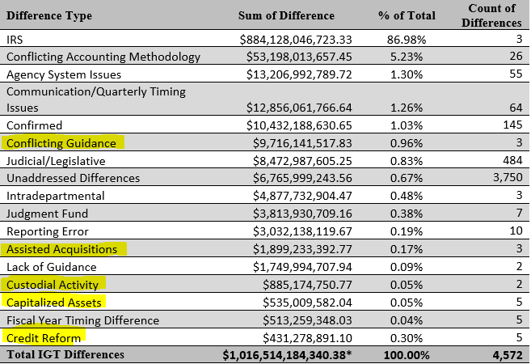
IGT Differences by Type (Q5 FY17)

Slide 9
USSGL Projects
Completed several pieces of guidance to address those IGT differences including Credit Reform Guidance & Assisted Acquisition Guidance.
During the year we will be working on Repayable Advance Guidance & Custodial Guidance to help reduce those IGT differences.
Continue work on the Budget Accrual Reconciliation and Schedule F for agencies.

Slide 10
Christopher Beck
Department of the Treasury Bureau of the Fiscal Service
(304) 480-7122
Christopher.Beck@fiscal.treasury.gov
USSGL.Issues@fiscal.treasury.gov

